Slide 1
countable VS uncountable
Όνομα Εκπαιδευτικού
Σχολείο

Slide 2
What do we mean by this?
countable
Are the things that we can count
1,2,3...books
1,2,3... Bananas
1,2,3... Apples
1,2,3... Houses
1,2,3... dolls

Slide 3
What do we mean by this?
uncountable
Are the things that we can’t count
Liquids (water, wine, beer , coffee , tea etc.)
Chocolate
Sugar
Butter
Toothpaste
Salt, pepper
Cereal
Pasta
Cheese
Meat
Money
hair

Slide 4
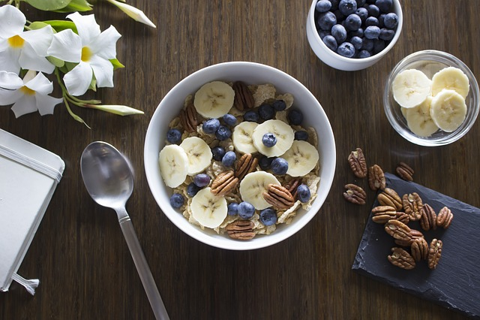
Uncountable nouns
Instead of using a or an, there are some phrases to show the weight, the package etc.
A pair of
A bottle of
A bowl of
A carton of
A tube of
A box of
A packet of
A kilo of

Slide 5
Some VS Any
some
any
We use some in affirmative
Exception: would you like some tea?
We use any in questions
We use any in negative

Slide 6
Quantifiers
countable
uncountable
Many (negative + questions)
How many? (questions)
A lot of/lots of (affirmative)
A few (questions + affirmative)
Much (negative + questions)
How much? (questions)
A lot of/lots of (affirmative)
A little (questions + affirmative)

