Slide 1
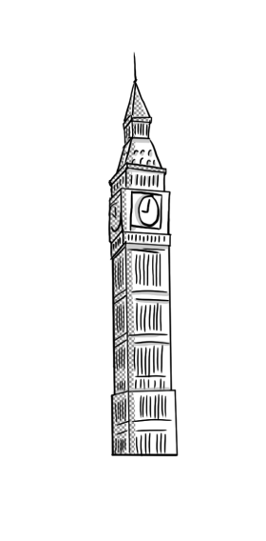
Tourists love visiting places
Όνομα Εκπαιδευτικού
Σχολείο

Slide 2
The return of the Parthenon sculptures
Channel 4 on British TV made a programme about the Parthenon sculptures called “Fifteen to one”.

Slide 3
The return of the Parthenon sculptures
During the programme, 100,000 people called the TV station and gave their opinion about the return of the sculptures to Greece.

Slide 4
The return of the Parthenon sculptures
92.5% of the people who voted said that they believed the sculptures must return to Greece.

Slide 5
The return of the Parthenon sculptures
So, 100 members of the Parliament are asking the queen to discuss the return of the sculptures with the Greek government.

Slide 6
The return of the Parthenon sculptures
What do you think? Should the Parthenon sculptures return to Greece? How will you support this request?

