Slide 1
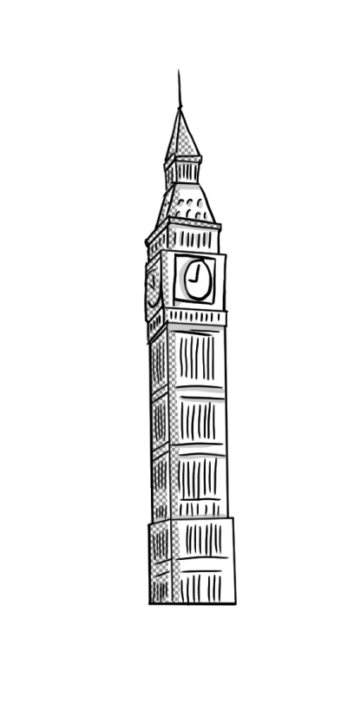
Animals in Danger
Όνομα Εκπαιδευτικού
Σχολείο

Slide 2
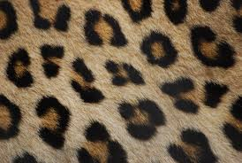
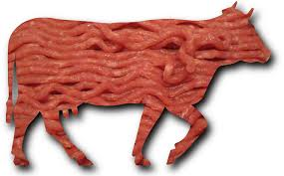
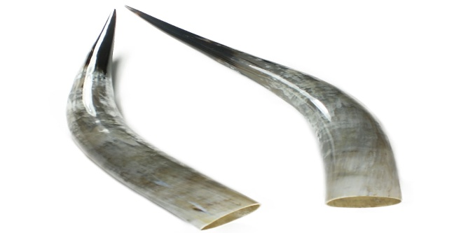
Hello children! Lots of animals are in danger in our planet!
People kill animals for their fur.
Their meat.
Their horns.

Slide 3
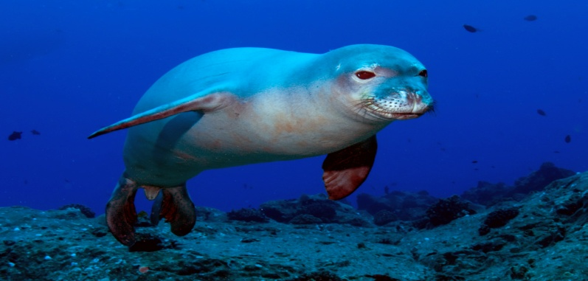
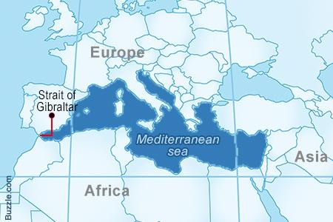
The monachus monachus seals are in big danger.
People kill them for their meat and a strange oil that comes from their body!
Only six hundred (600) monachus monachus seals live in the Mediterranean Sea!!

Slide 4
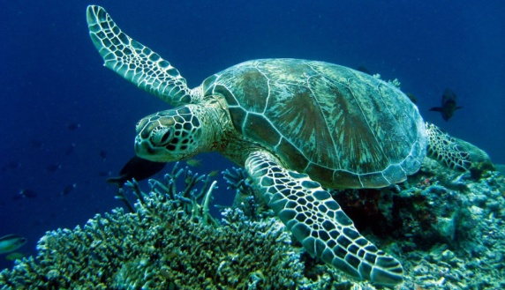
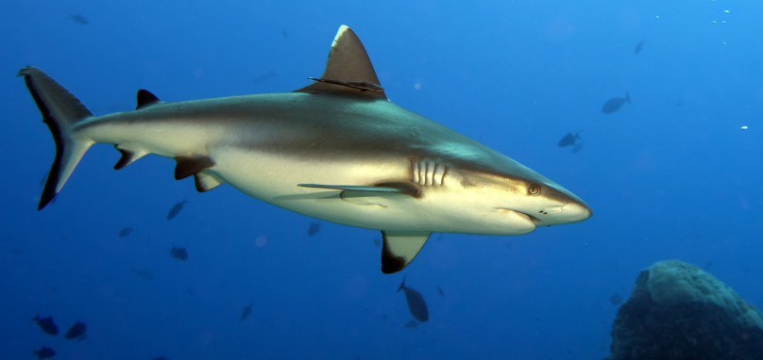
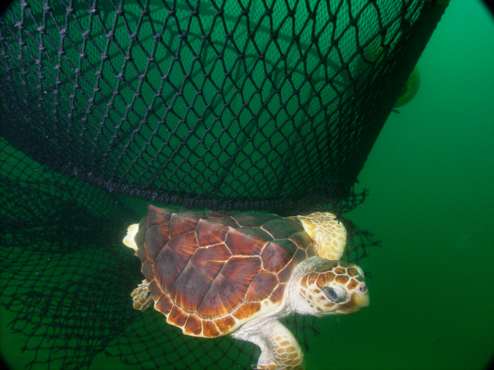
The caretta caretta turtles are in danger, too.
The carreta carreta turtles are in danger because sharks eat them
… or fishing nets kill them.
Only two thousand two hundred (2,200) turtles live now!!

Slide 5
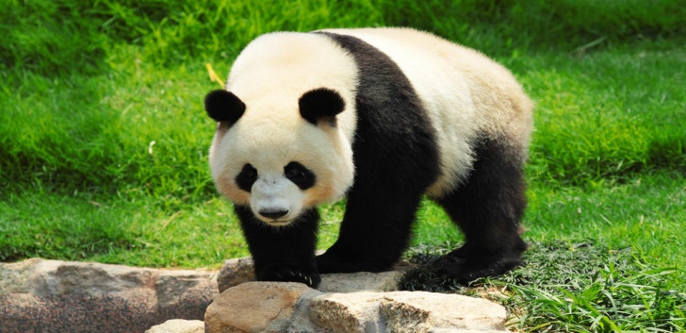
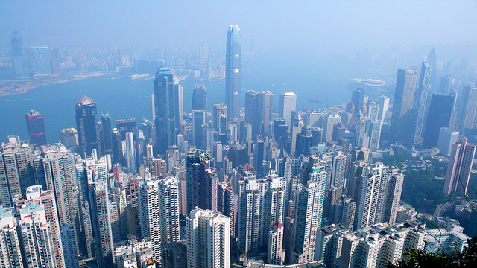
Giant pandas are also endangered animals.
They are in danger because people build houses and buildings in their habitat, the place they live in.
There are only two thousand (2,000) giant pandas.

Slide 6
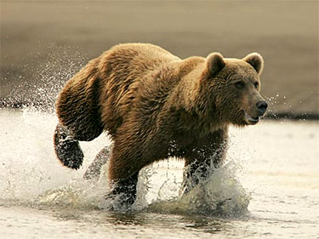
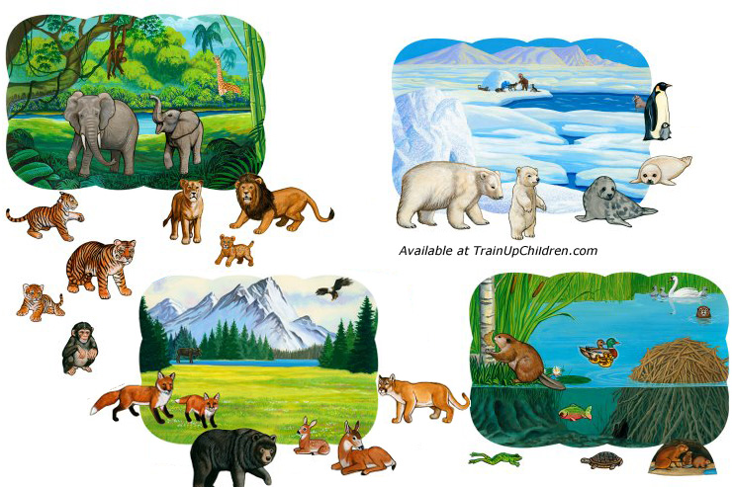
The brown bear is an endangered animal, too!
Brown bears are in danger because people take their fur and their habitat.
There are only two thousand (2000) brown bears in the planet.

Slide 7
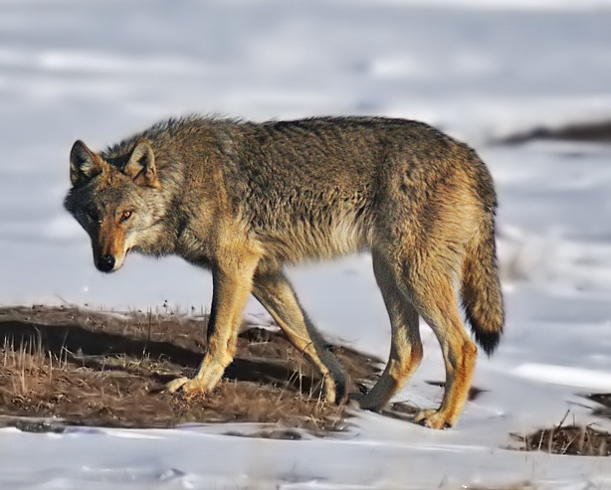
Finally, wolves are in great danger, too!!
They are endangered because people take their fur and their habitat.
There are twenty thousand (20,000) wolves on Earth!!

Slide 8
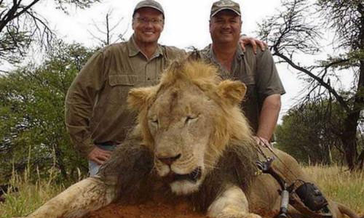
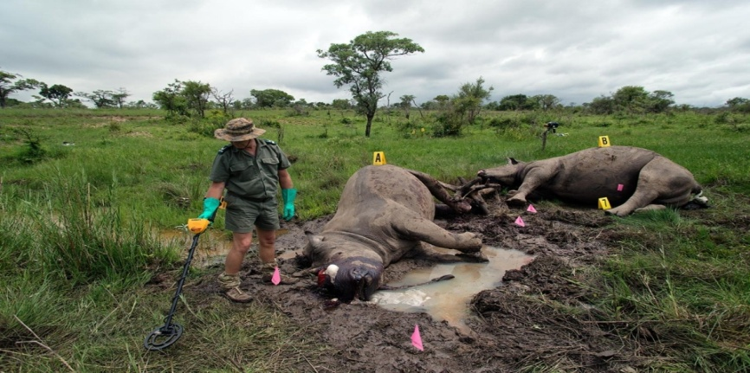
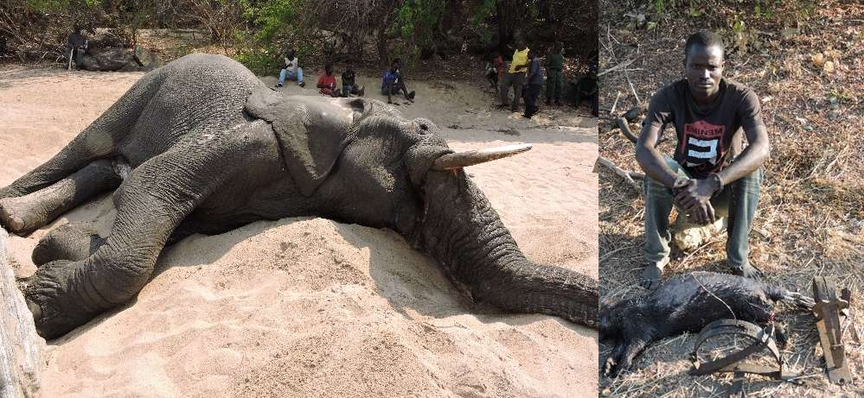
Poachers are hunters!!
They kill animals and this is very bad!!
Lots of animals are endangered because of them….

